Slide 2

Perspectives on Continuous Integration at Scale
Vinaya Muralidharan
@vinaya1980
Hrishikesh Karekar
@hrishikarekar

Slide 3










Who are we?
30+ years of experience
250 + Communication Service Providers
Over 95% success rate
Leading the OSS/BSS space
some of our customers…

Slide 4
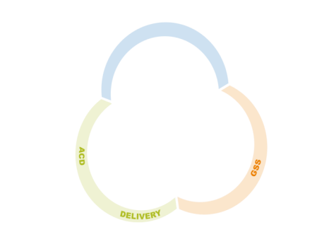
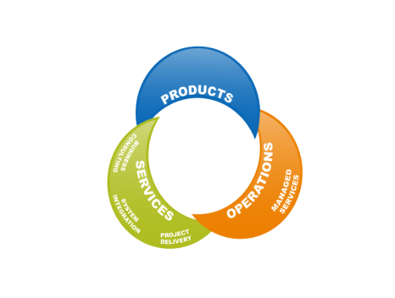
Amdocs Delivery
5000+ delivery experts
Mega Transformations

Slide 5
Technology
Operating Environment
Service Delivery
Traditional Automation
We are Unique
Integration Challenges
Legacy Infrastructure
Not Product Development
Multi Product – Multi Technology – Multi Team
Source control & Build Systems
Record and Play
Array of homegrown tools & standards
Build is a big event
Takes days
Code works on my machine

Slide 6
Process
Operating Environment
Large transformation projects
Upfront planning due to multi-vendor environment

Slide 7
People
Operating Environment
Super specialization
Component Teams
Not Feature teams
products

Slide 8


Where are we today
Environments
Build Time
Time to clone environment reduced due to EaaS
13 days
Monthly ability to deliver working software to UAT
With major scope
8 Hrs
4 Hrs
90%
Goal
Build Running every
Compilation no longer a blocker
3
1
Weeks
Nights

Slide 9
The New Reality

Slide 10
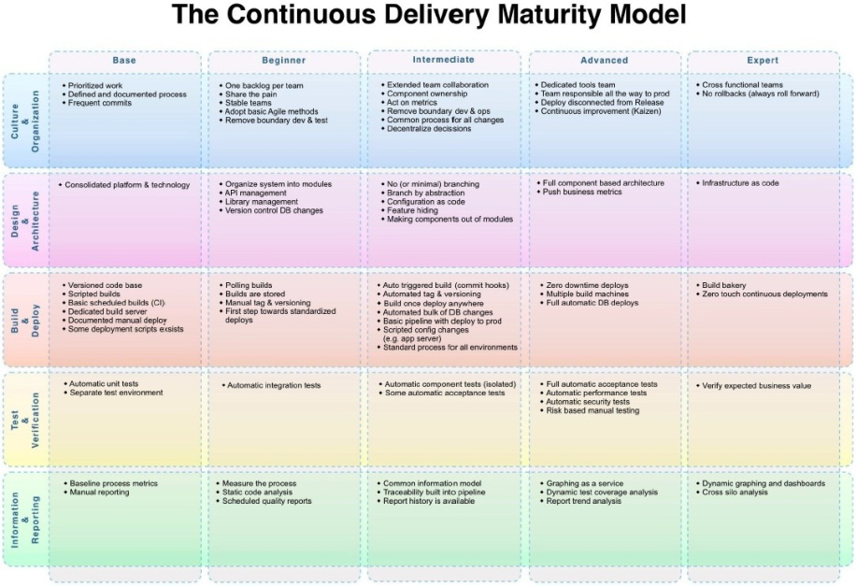
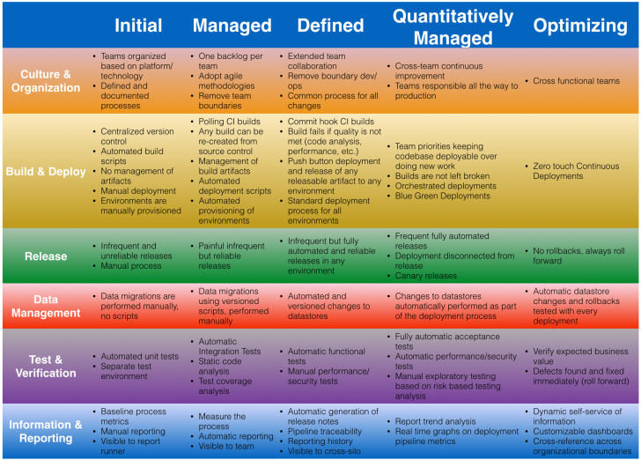
The Continuous Delivery Maturity Model
representative
The New Reality
http://www.infoq.com/articles/Continuous-Delivery-Maturity-Model
http://blog.arungupta.me/wp-content/uploads/2015/02/continuous-delivery-maturity-model-v1.0.png

Slide 11
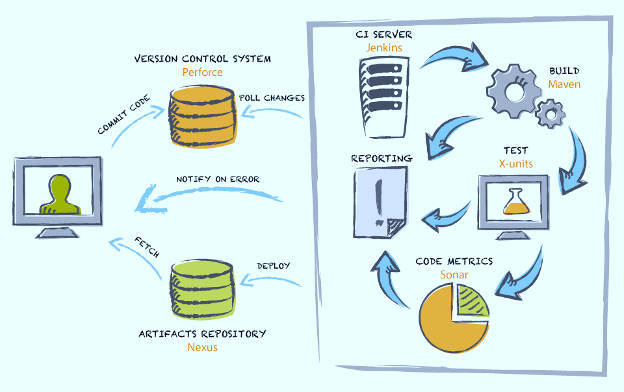
Starting to modernize
The New Reality

Slide 12
Technology
The New Reality
Technical debt
Modern Version Control system
Inverting the Test Automation pyramid
UT automation
Safety net for refactoring
Development Environment cloning
Simplified build order and dependency management
Modular builds
Moving from imperative to declarative
Artifact management
measured and managed
Deploy portfolio integrated build
CI stack – reliance on open source

Slide 13
Process
The New Reality
Lean and visual documentation
Code Inspection approach
UT Defect logging
Software packages delivered more frequently
Frequent check-ins
Stop the line
Several times a day
Left to the teams
Lightweight and relevant
Iterative – Incremental – Fast Turnaround

Slide 14
People
The New Reality
Developer viewed as craftsman
Developer engagement
Gamification
Improving developer productivity
Empowerment – Autonomy

Slide 15
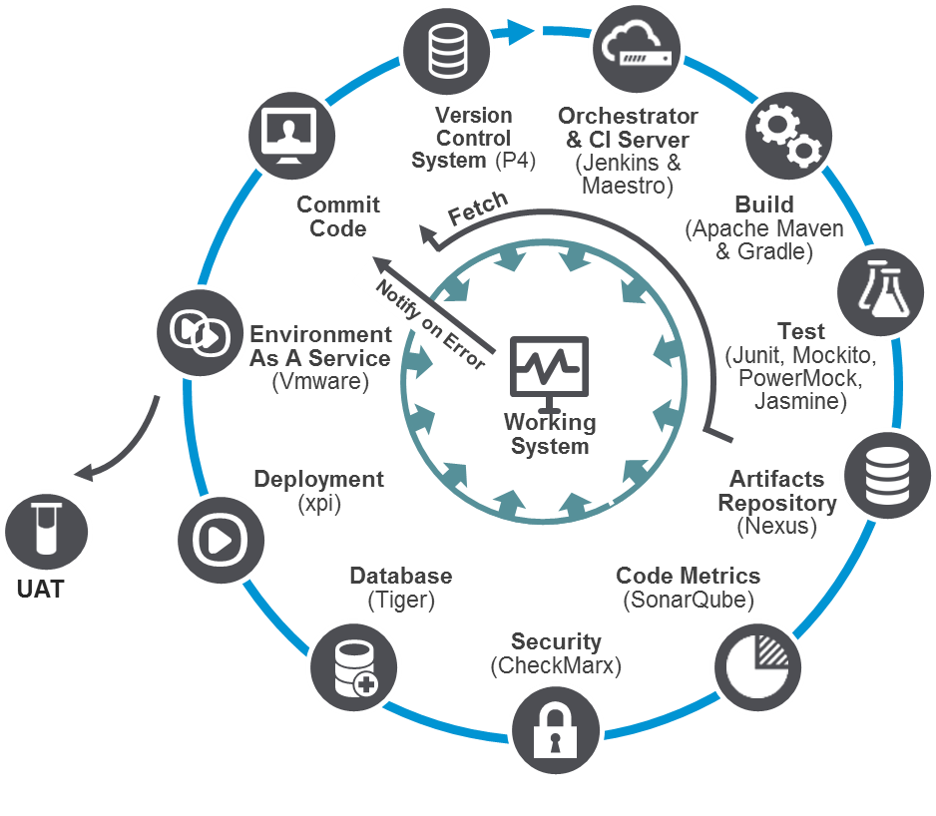
Evolved Continuous Integration Framework
The New Reality

Slide 16
What we learned
STOP the line is critical
One team cannot go CI
Daily check ins are a must
CI Useless without automation
UT automation targets – don’t work
Don’t alienate middle management
Focus on clean code will go a long way
Rely more on build, not Hot Fixes
Gamification
Workshops

Slide 17
Thank You
@hrishikarekar
@vinaya1980

